Slide 1
ANALYSIS ON PIMA INDIANS DIABETES DATABASE
BY Shubham Gulia
Pankaj Tulaskar
Ankur Gyani
Pranav Bawa

Slide 2
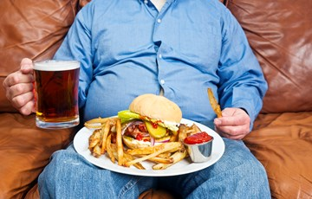
OBJECTIVE
Analyzing the PIMA INDIAN DIABETES DATABASE to predict the occurrence of diabetes among individuals based on diagnositc measures.
To prepare and train a model based on Naive bayes classifier and Neural Network.
To prepare and train a model using SVM classifier to determine the effects of certain groups of predictor variables on the potential target variable(outcome) to determine which attributes are most impactful in decision making and analysis.
To compare all the three models based on confusion matrix to determine which model has the best accuracy results to support the decision making.

Slide 3
DATA SOURCE
Data for the project is taken from Kaggle.com. This dataset is originally from National Institute of Diabetes and Digestive and Kidney Diseases.
Dataset information
Several constraints were placed on the selection of these instances from a larger database. In particular, all patients here are females at least 21 years old of Pima Indian heritage.

Slide 4
ABOUT THE DATASET
pregnancies : Number of times pregnant
glucose : Plasma glucose concentration a 2 hours in an oral glucose tolerance test
bloodpressure : Diastolic blood pressure (mm Hg)
skinthickness : Triceps skinfold thickness (mm)
insulin : 2-Hour serum insulin (mu U/ml)
bmi : Body mass index (weight in kg/(height in m)^2)
dpf : Diabetes pedigree function
age : Age (years)
diabetes? : Class variable (0 or 1). “0” implies No Diabetes. “1” implies Diabetes.

Slide 5
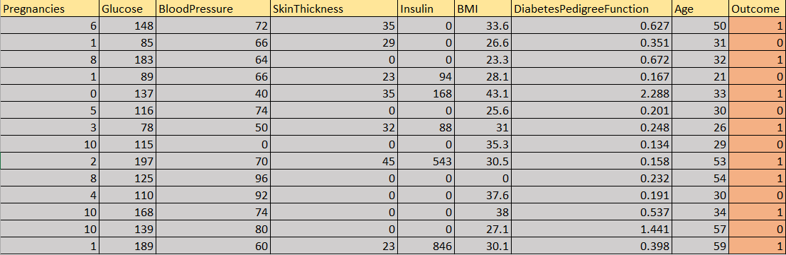
ORIGINAL DATASET
Number of rows in the Dataset: 768

Slide 6
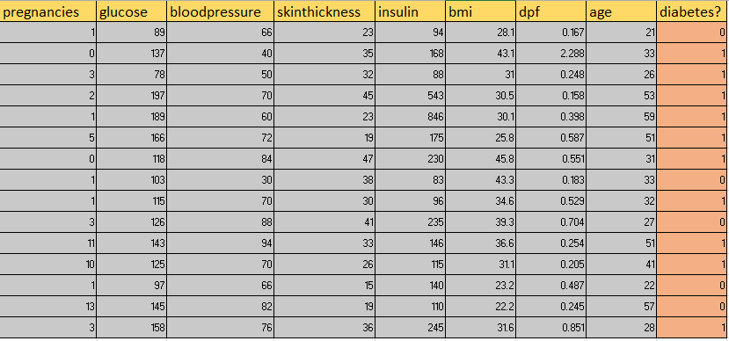
DATASET AFTER CLEANING
The number of rows in Dataset after cleaning: 392

Slide 7
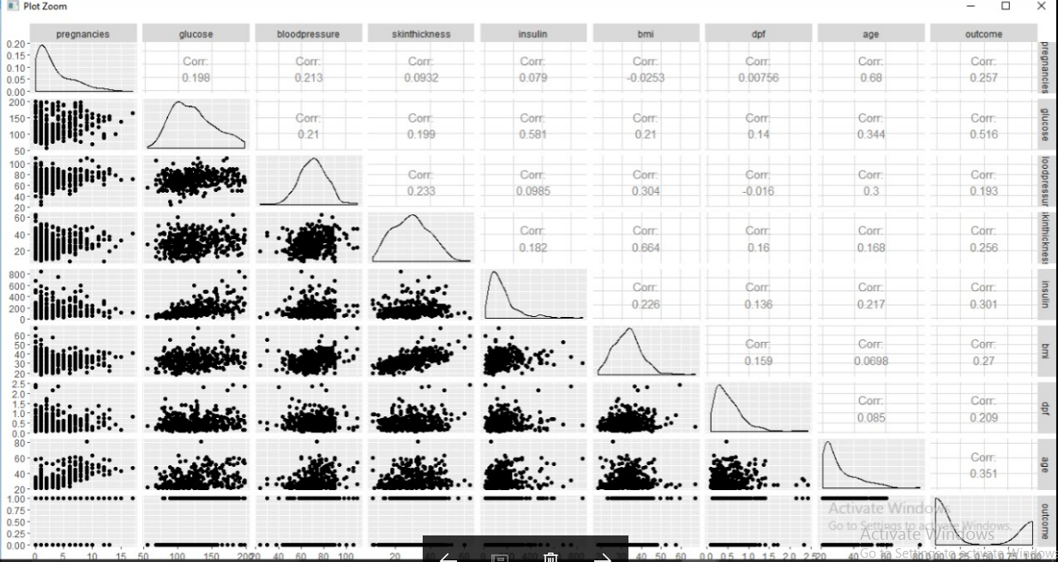
CORRELATION OF THE VARIABLE IN THE DATASET

Slide 8
NAIVE BAYES CLASSIFIER
Naive Bayes is a simple technique for constructing classifiers: models that assign class labels to problem instances, represented as vectors of feature values, where the class labels are drawn from some finite set.
It is particularly suited when the dimensionality of the inputs is high.
One of the application of Naive Bayes classifier: It is among the most successful known algorithms for learning to classify text documents.
Advantage: Requires a small amount of training data to estimate the parameters.

Slide 9
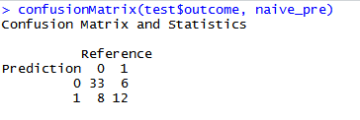
Out of 392 rows,number of rows considered for training is 333 and 59 rows were used for prediction.
Naive Bayes Classifier predicted 45 rows correctly and remaining 14 were not predicted correctly.

Slide 10
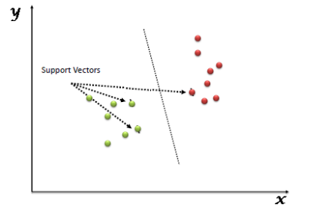
SVM MODEL
“Support Vector Machine” (SVM) is a supervised machine learning algorithm which can be used for both classification or regression challenges. However, it is mostly used in classification problems.
In this algorithm, we plot each data item as a point in n-dimensional space (where n is number of features you have) with the value of each feature being the value of a particular coordinate. Then, we perform classification by finding the hyper-plane that differentiate the two classes very well.

Slide 11
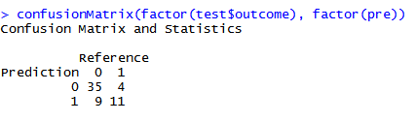
Out of 392 rows,number of rows considered for training is 333 and 59 rows were used for prediction.
SVM Model predicted 46 rows correctly and remaining 13 were not predicted correctly.

Slide 12
NEURAL NETWORKS
Neural networks have been shown to be very promising systems in many forecasting applications and business classification applications due to their ability to “learn” from the data, their nonparametric nature (i.e., no rigid assumptions), and their ability to generalize.
Utilizes a functional form that best equates explanatory variables and the target variable in a manner that minimizes the error between what the model had produced and what actually occurred in the past and then applies this function to future data.
Disadvantage: More complex as they incorporate intensive program architectures in attempting to identify linear, non-linear and patterned relationships in historical data.

Slide 13
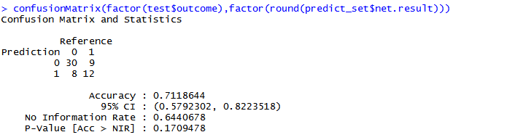
Out of 392 rows,number of rows considered for training is 333 and 59 rows were used for prediction.
Neural Networks predicted 42 rows correctly and remaining 17 were not predicted correctly.

Slide 14
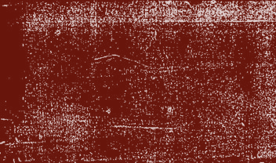
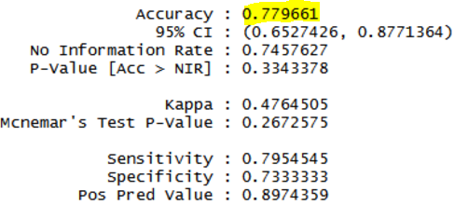
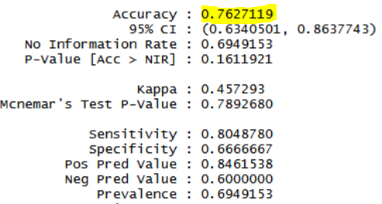
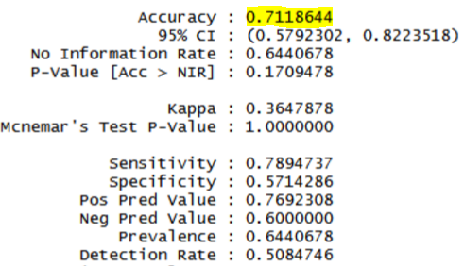

NAIVE BAYES VS NEURAL NETWORKS VS SVM MODEL
SVM MODEL
NAIVE BAYES CLASSIFIER
NEURAL NETWORKS

Slide 15
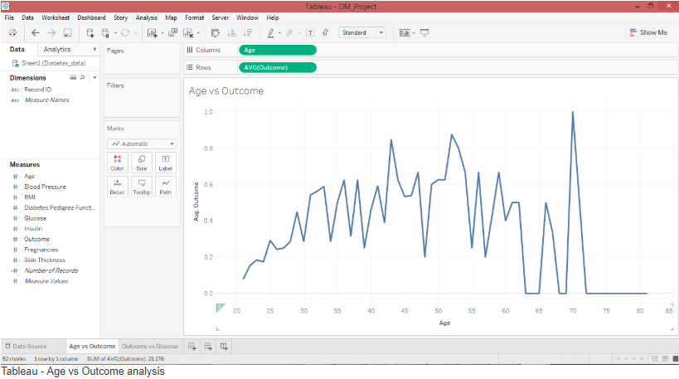

Slide 16
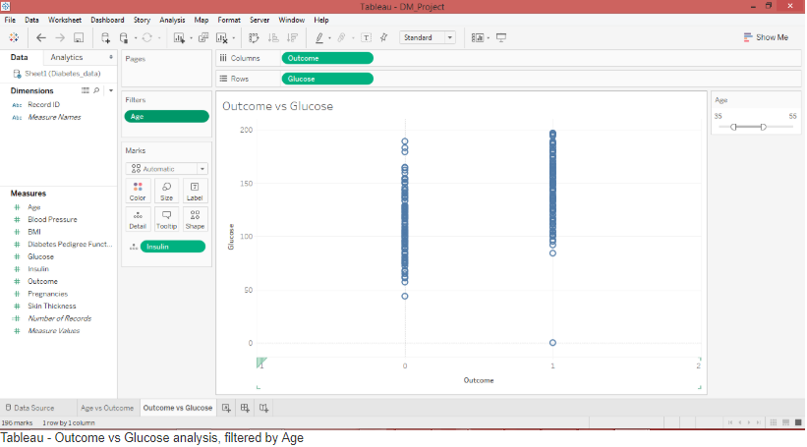

Slide 17
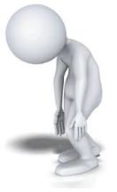
CHALLENGES
Data set had to be cleaned to eliminate rows where the columns glucose, bloodpressure, skinthickness, insulin, BMI, DiabetesPedigreeFunction, age have the value ‘0’.
Identifying the right packages for the models.

Slide 18

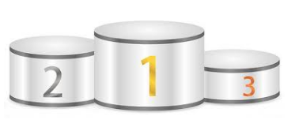



CONCLUSION
Ranking the models based on their accuracy:

Slide 19
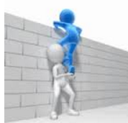
REFERENCES
http://software.ucv.ro/~cmihaescu/ro/teaching/AIR/docs/Lab4-NaiveBayes.pdf
https://en.wikipedia.org/wiki/Naive_Bayes_classifie
https://www.analyticsvidhya.com/blog/2015/10/understaing-support-vector-machine-example-code/
Book: data Mining and Business Intelligence by Stephan Kudyba and Richard Hoptroff
https://www.kaggle.com/uciml/pima-indians-diabetes-database
https://github.com/ShubhamGulia/WEB-MINING

Slide 20

THANK YOU

